Slide 1
Employee Data Analysis using Excel
STUDENT NAME: SHALUMOL S
REGISTER NO: 312216149 asunm1621312216149
DEPARTMENT: B.COM ACCOUNTING AND FINANCE
COLLEGE: SHRI SHANKARLAL SUNDARBAI SHASUN JAIN COLLEGE FOR WOMEN

Slide 2
PROJECT TITLE
Employee Performance Analysis using Excel

Slide 3
AGENDA
Problem Statement
Project Overview
End Users
Our Solution and Proposition
Dataset Description
Modelling Approach
Results and Discussion
Conclusion

Slide 4

PROBLEM STATEMENT
Employee Performance is based on very high, high and low performance. High-performing employees are often characterized by their ability to go above and beyond, while low-performing employees may struggle to meet expectations.

Slide 5

PROJECT OVERVIEW
Setting goals and objectives is a key to maintaining performance of every employee. The performance review should address this area not only to improve their performance of your employees but also to strengthen their accountability to your business.

Slide 6

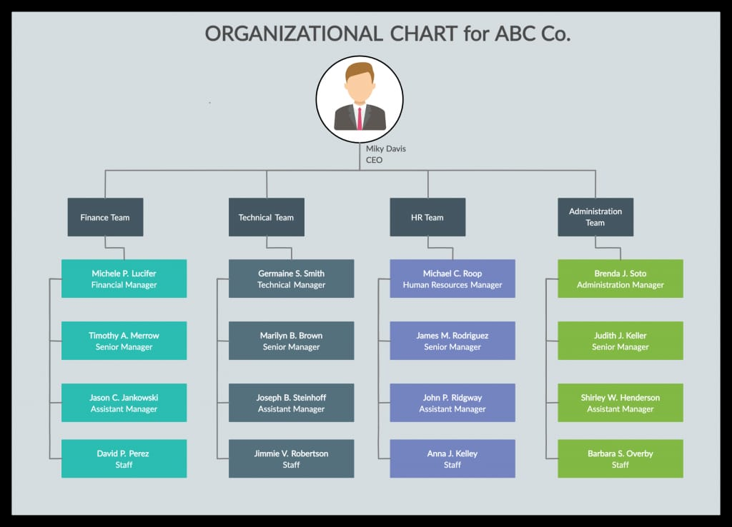
WHO ARE THE END USERS?

Slide 7


Conditional Formatting – Missing
Filter – Remove
Formula – Performance
Pivot – Summary
Gragph – Data Visualization

Slide 8


Employee – Kaggle
26 – Feature
9 – Feature
Employee ID – Numerical
Name – Text
Employee Type
Performance Level
Gender – Male and Female
Employee Rating – Numerical values

Slide 9


Performance level = IFS (Z8>=5,”VERY HIGH”,Z8>=4”HIGH”,Z8=3,”MTD”,TRUE,”LOW”)

Slide 10


Data Collection
Features Collection
Data Cleaning
Performance Level
Summary

Slide 11

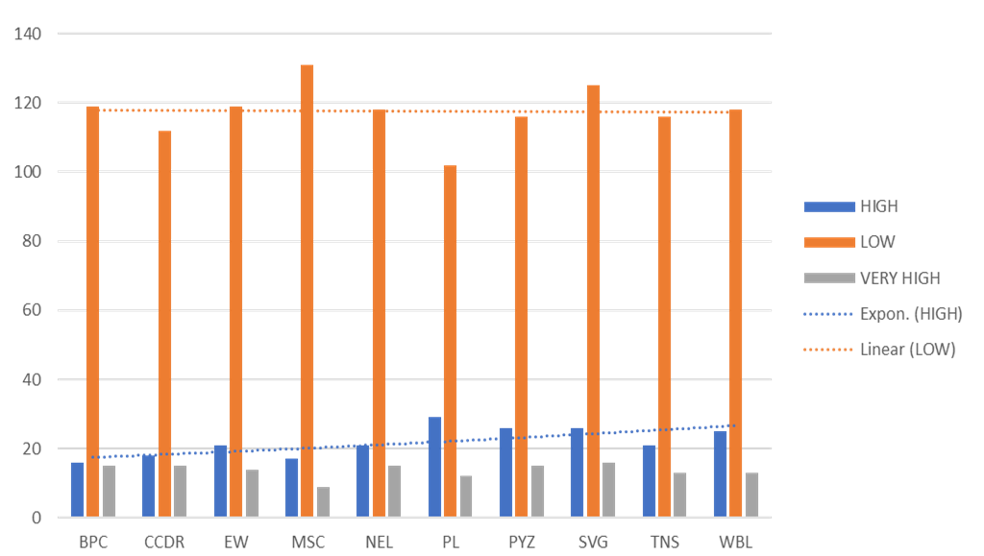

Slide 12

Employee performance management is an essential part of any successful organization. It provides the necessary feedback to develop employees, encourage growth, and align goals with company objectives.

